Slide 1
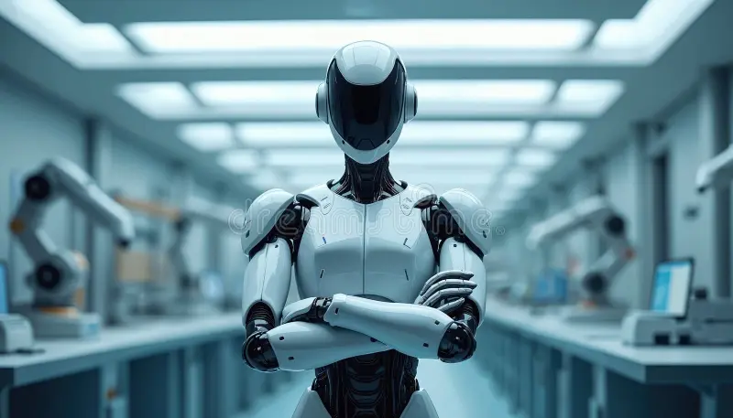
Tech Product Invent and Launch
Holographic Disc • Smart AI Mirror • Smart AI Robot

Slide 2

Group Members:
Qiraat Tahir – 2025-GA-50
Ayesha Fayaaz – 2025-GA-21
Meerab Zahid – 2025-GA-43
M. Daud Butt – 2025-GA-38
Umair Abu Bakar – 2025-GA-04
Course: AICT Lab Instructor:
Ms. Ramsha Khalid

Slide 3
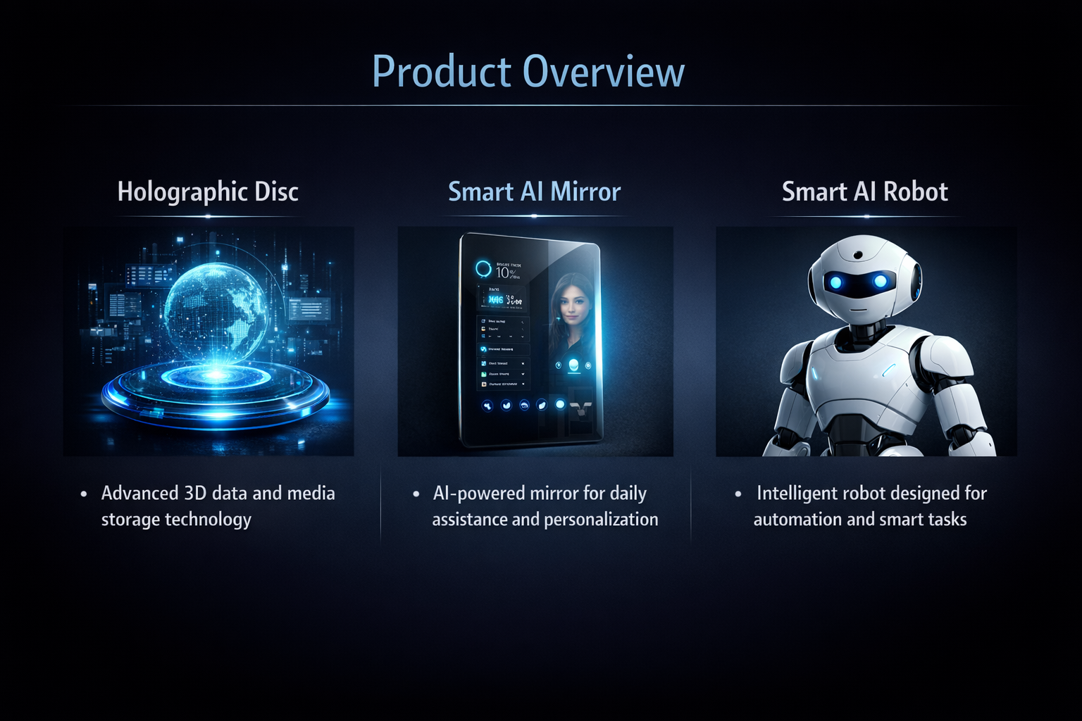
To design and launch a professional website
To analyze user interest using Excel data
To present the project in a structured and professional way
“The main objective of this project was to combine innovation, web design, and data analysis to present and launch new technology products in a professional way.”

Slide 4
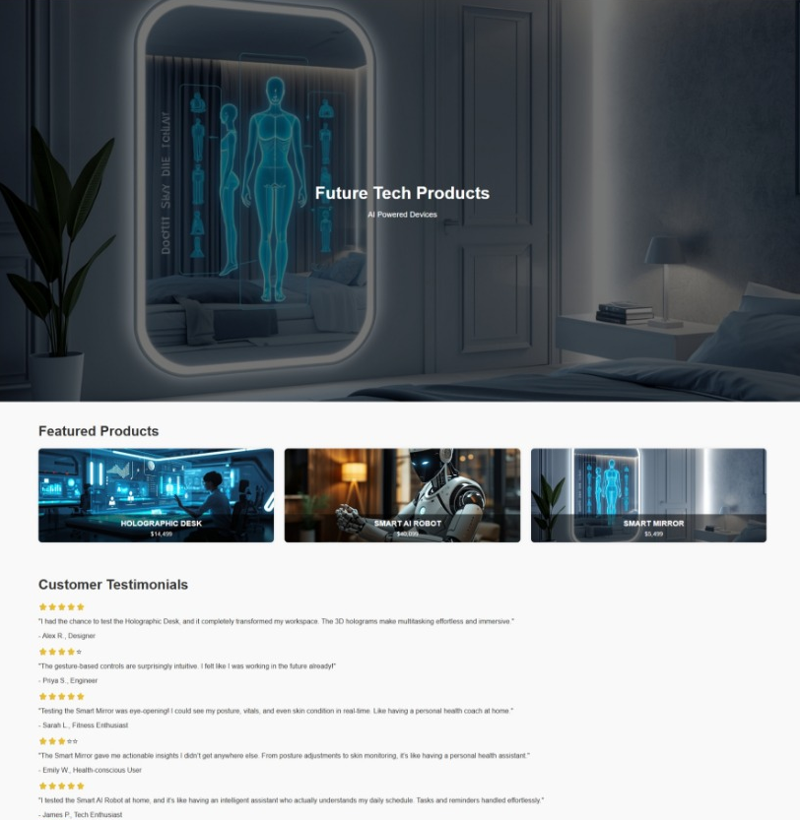
Website Demo: Home Page
Introduces the project and tech vision
Displays featured products clearly
Clean, modern, and futuristic design

Slide 5
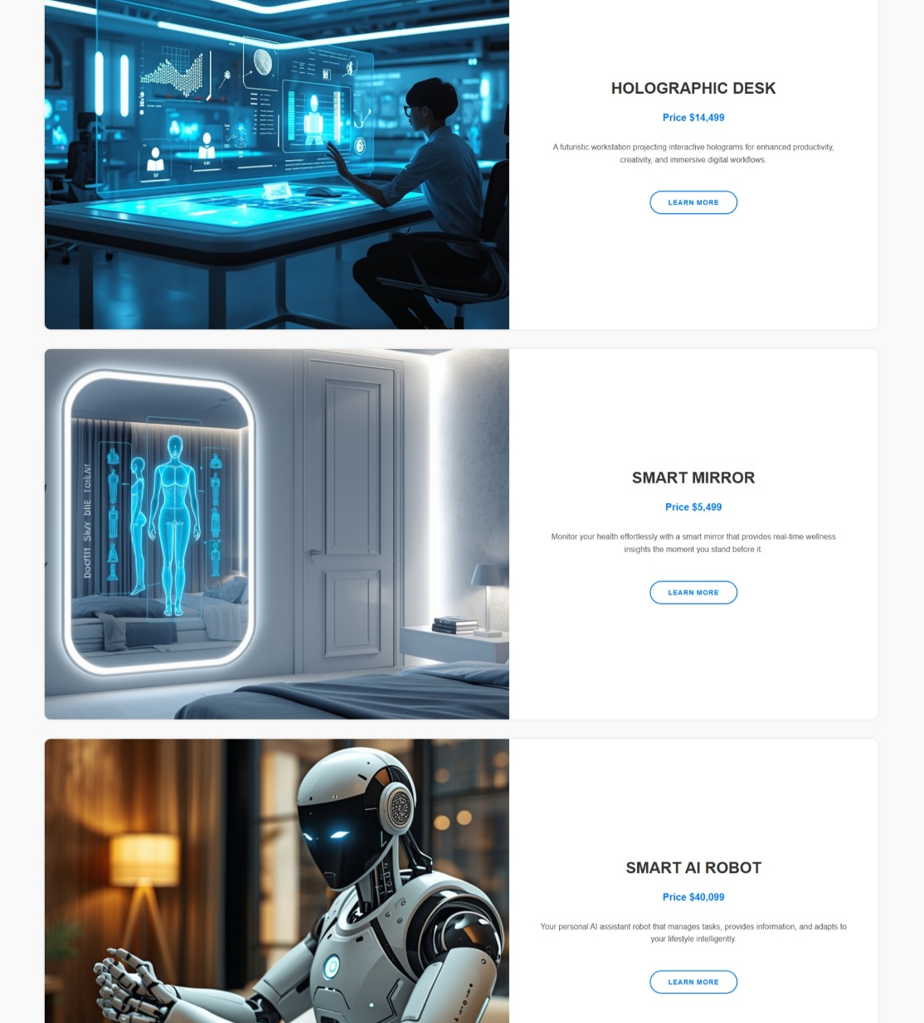
Website Demo: Product Page
Detailed description of each tech product
Highlights features and use cases
User-friendly and visually appealing layout

Slide 6
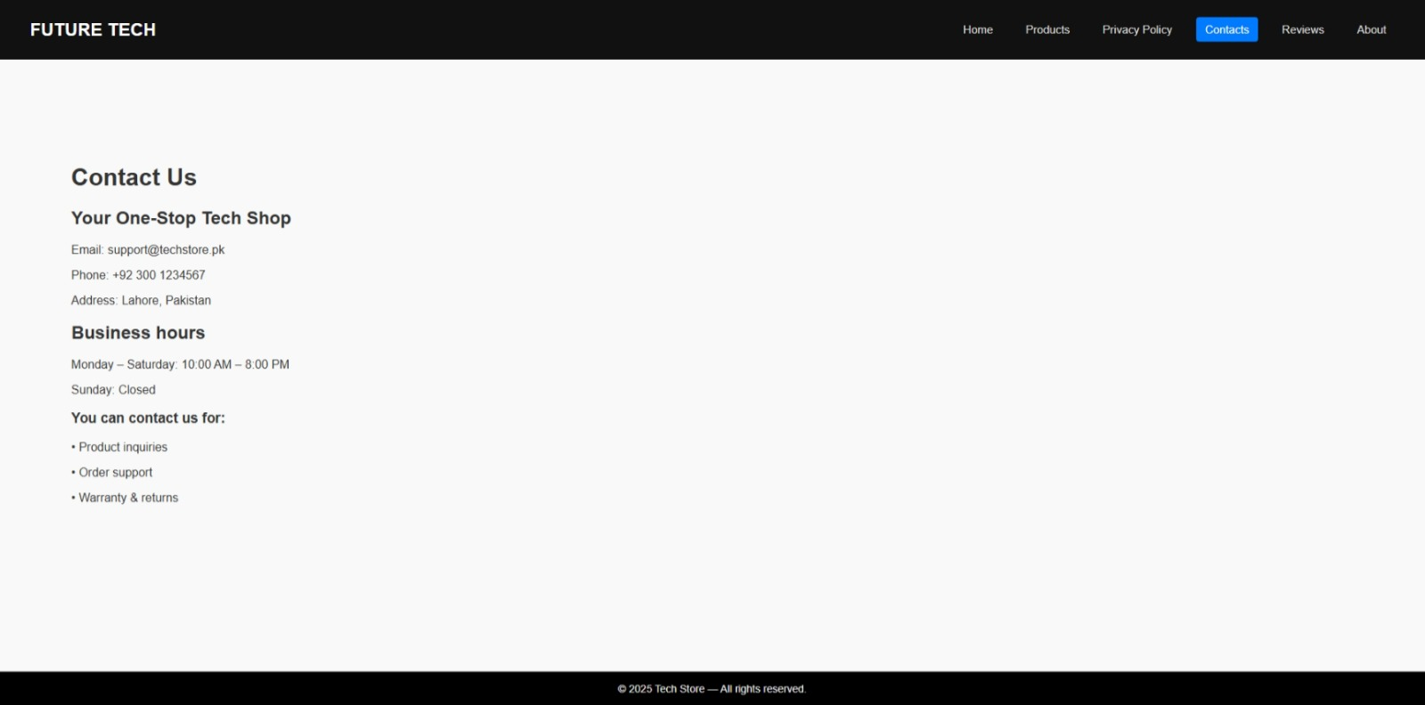
Website Demo: Contact Page
Allow user to contact the team
Collect feedback and inquiries
Gives the website a professional and complete look

Slide 7
Excel Data & Chart Analysis:
Excel used to analyze user interest in products
Chart compares popularity of::
Holographic Disc
Smart AI Mirror
Smart AI Robot
Helps in understanding market demand

Slide 8
Profit & Market Potential:
These tech products target future-focused consumers and smart living
High demand for AI and immersive technologies increases profit potential
Initial costs are high, but long-term returns are promising
Revenue can be generated through product sales, subscriptions, and upgrades
Scalability allows profits to grow with market expansion

Slide 9
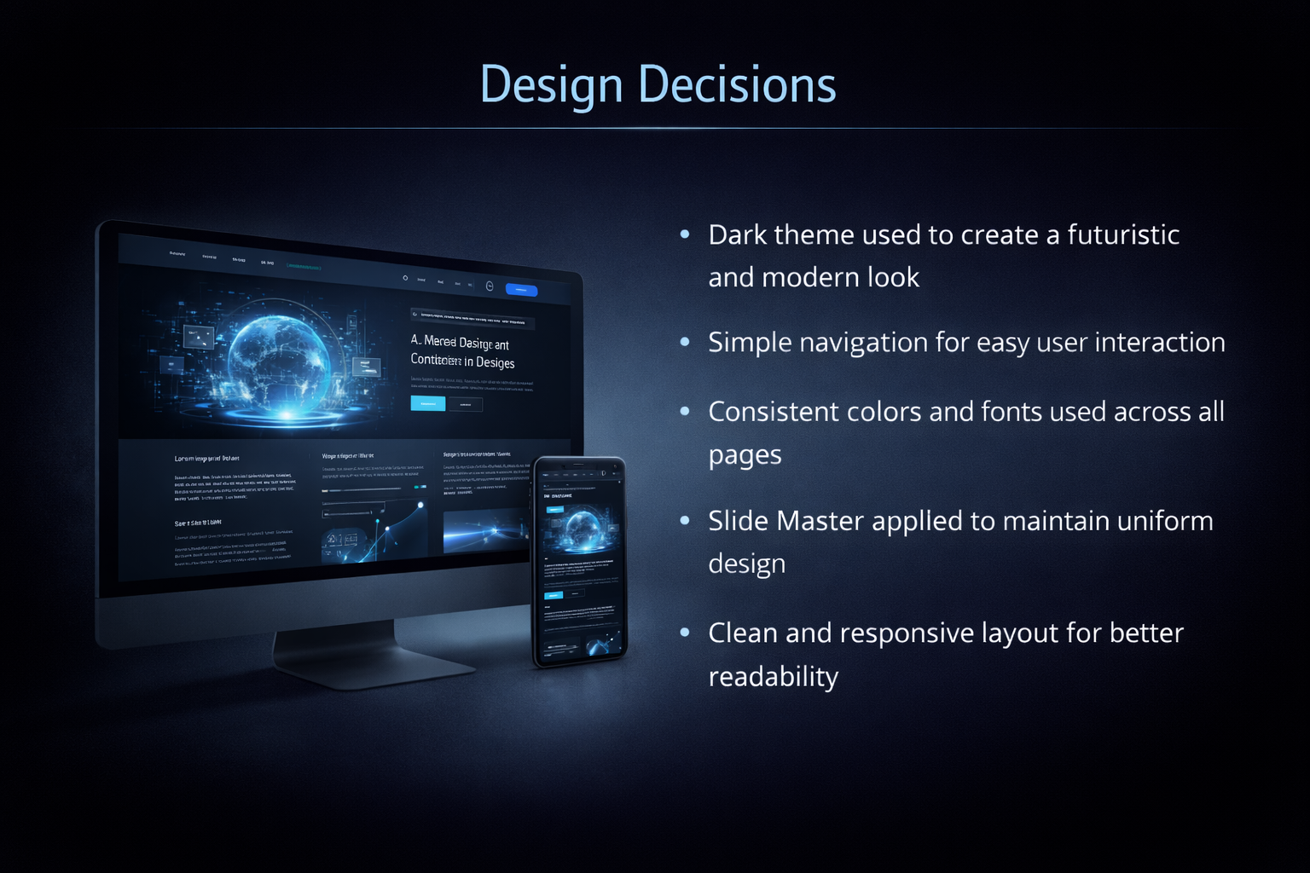
Design Decisions:
Dark theme used to create a futuristic and modern look
Simple navigation for easy user interaction
Consistent colors and fonts used across all pages
Slide Master applied to maintain uniform design
Clean and responsive layout for better readability

Slide 10

Live Demo & GitHub:
GitHub:
Project is uploaded on GitHub. Links are given below:
https://github.com/QiraatTahir2006/AICT

Slide 11
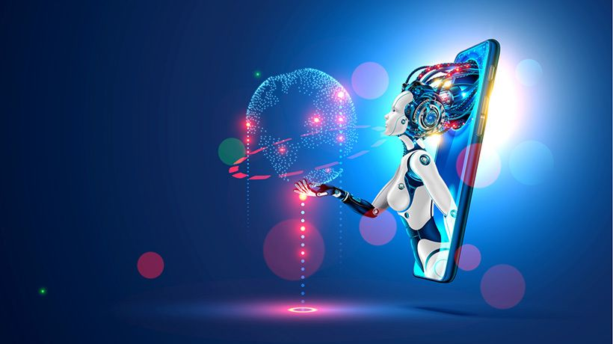
Reflection & Future Enhancements:
Learned web development and data analysis skills
Improved understanding of product design and presentation
Future improvements:
Add backend functionality
Integrate real AI features
Improve UI and user interaction

Slide 12
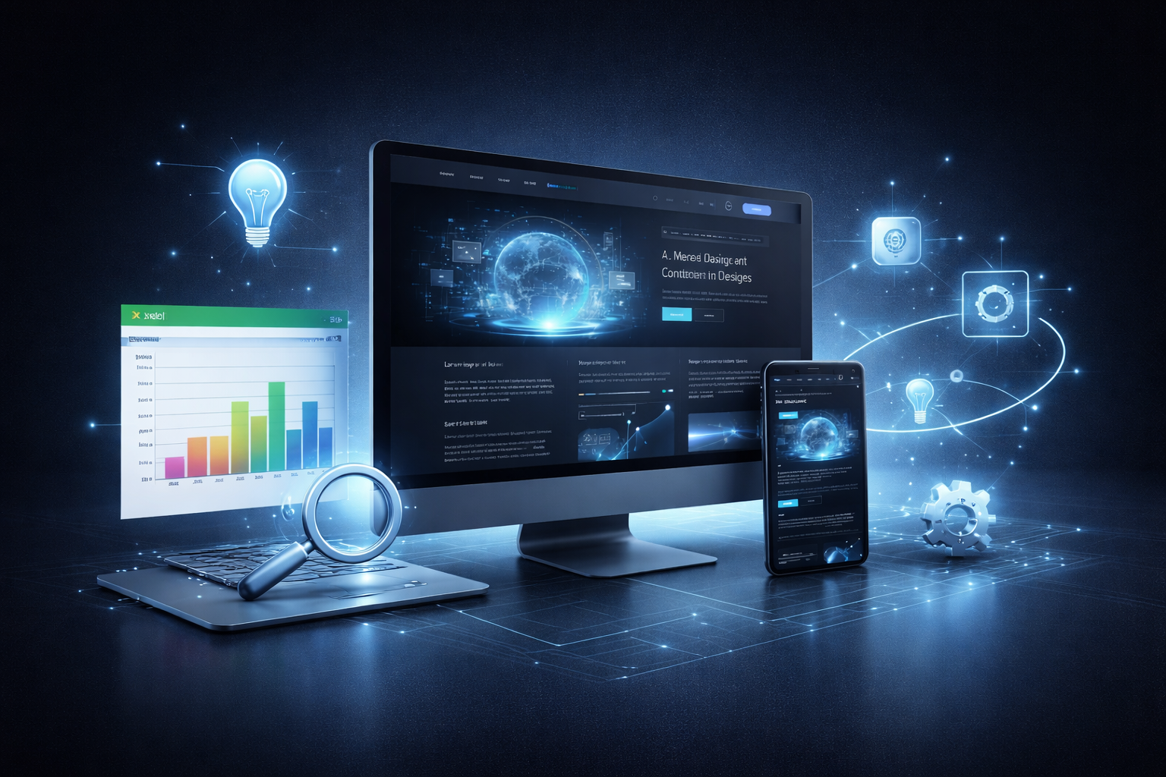
Wrapping Up:
This project focused on inventing and presenting modern tech products
A professional website was designed to showcase the products
Excel data and charts helped analyze user interest
Design decisions ensured a clean, futuristic, and user-friendly layout
Overall, the project combined creativity, technical skills, and analysis
THANK YOU!

